Slide 1
t h e f e s t i v a l r e v o l u t i o n

Slide 2
Overview
Video-on-demand (VoD) Market
$25B for 2014
$50B (est.) by 2019
Cinewav
We're ready to create a new future for independent film by challenging the existing distribution model.
Are You?
We’re searching for $0.5M seed funding in H1 2015.
An additional $1.0M funding is scheduled in H2 2015.

Slide 3
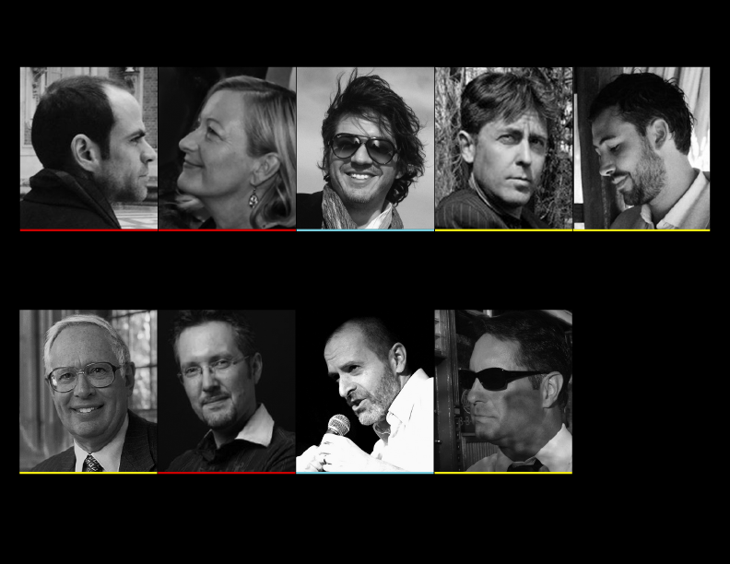
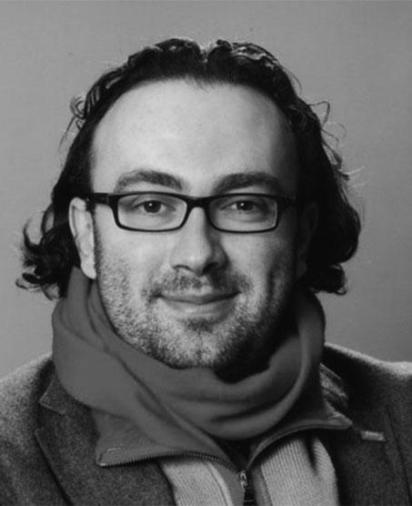
Team: Executive Management & Advisory Board
Matthieu DeGenevraye
CFO
Controller, ORANGE
Co-Founder, LE FABSHOP
(silent partner)
Festival Relations
International Relations,
(major international festival)
German Rodriguez
Founder, Chairman
Founder, INSIDEFILMS
Mark Swindle
CEO
Sr Designer, NU
Co-Founder, TQGD
Joseph Jorgensen
CTO
VP, Code & Theory
Partner, CTO HYPER HYPER
Henry Bienen
(tentative)
President Emeritus,
NORTHWESTERN UNIVERSITY
Omar Soubra-Pierre
Director,
TRIMBLE
Cory McAbee
Filmmaker, Writer, Musician, Actor
Nikolaj Nikitin
(tentative)
Founder & Director,
SOFA
Delegate Eastern Europe,
Berlinale

Slide 4
Overview: Existing Model of Film-VoD Distribution
VoD Market
Mainstream
Fandor
Netflix
Amazon
Hulu
Mubi
Google
Major Film Studios
Warner, Sony, MGM, Paramount, Universal
Theaters
Independent
Films
Film
Festivals
DIY
Reelhouse
Vimeo
Indieflix
Distrify
VHX
Snagfilms
Film Limbo

Slide 5
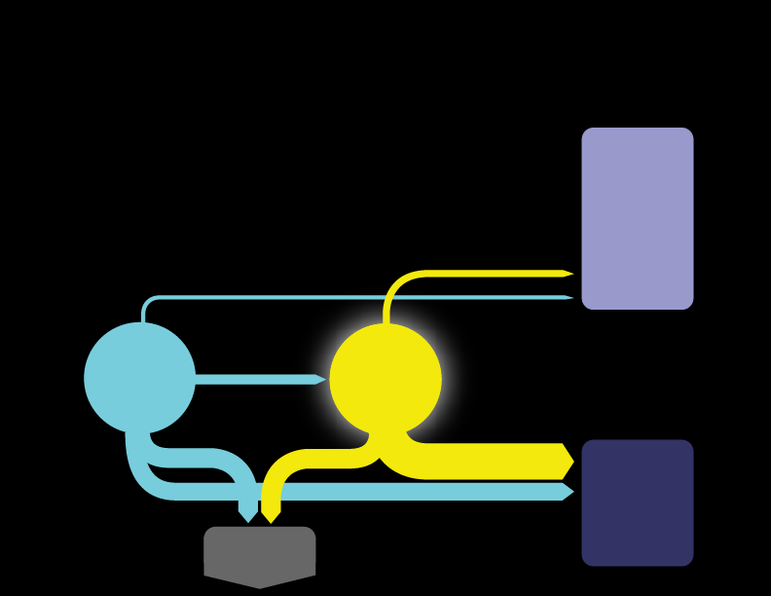
Opportunity: Film Festival Focus
Premium Content
Curatorial role / filtering process
Limited or Poor Distribution Channels
85-90% of filmmakers leave without a distribution deal.
10-15% of filmmakers leave with sub-optimal deal.
Festival Limitation & Market Size
Attendees see only 2-10 films per festival | 1-3 festivals per year.
4,000+ Festivals/year = ~30 million+ Attendees/year
VoD Market
Mainstream
Fandor
Netflix
Amazon
Hulu
Mubi
Google
10-15%
Independent
Films
5-10%
Film
Festivals
30%
55-60%
DIY
Reelhouse
Vimeo
Indieflix
Distrify
VHX
Snagfilms
Film Limbo

Slide 6
Opportunity & Challenge
Cinewav: the new entrant into the VoD market, focused on festival films.
No other VoD Platform is focused exclusively on this market.
Yet.
VoD Market
Film Festivals: Hidden In Plain View
Convert Festival films to Cinewav library films.
Convert Festival attendees into Subscribers.
Connect them.
Independent
Films
Film
Festivals
Cinewav

Slide 7
Solution: Cinewav Symbiotic Ecosystem
Subscribers
Premium Content: Selected festival films only
Affordable: $5 (€5)/month: unlimited viewing
Experience: Ad Free
Accessibility: available worldwide, streamed
to a multiplicity of devices, subtitled (English,
French, Spanish, German, Mandarin)
Subscribers
Revenue
Marketing
Content
Community
Film Festivals
Extended audience reach: post-festival 30-day VoD platform offering festival
library worldwide
Revenue stream: 40% of revenue post-festival;
1.5% permanent
Mission of film-filmmaker promotion
Brand recognition
Independent Filmmakers
Fair compensation: a generous 70% of
subscription fees
Fair allocation: with Advanced Tracking
Algorithm (ATA). More play = more pay
Global audience & multilingual platform
(subtitling service)
Non-exclusive contract option
Geo On/Off
Cinewav
Distribution Deal
Revenue
Global Audience
VoD Platform
Revenue
Global Audience
IndependentFilmmakers
Film Festivals
Content
Marketing
Subscribers
Partnerships
Brand Recognition

Slide 8
Implementation: Year 1: Post-Launch BUDGET ( 5-6 Months )
OPEX
Festival Relations & Acquisitions
Initial compensation pool for films
MARKETING
Marketing / Production
Online advertising
On-the-ground campaign
PAYROLL
Partner + Full-time (2)
Partner + Part-time (3)
Post- Year 1
OVERHEADS
Consultants
Work spaces (US, EU)
Travel
Legal
TECHNICAL
beta website maintenance
tools / services
infrastructure
post- Year 1
MISCELLANEOUS
TOTAL
$k
20.0
300.0
0.0
75.0
45.0
40.0
30.3
100.0
20.0
10.0
15.0
50.0
25.0
0.0
25.0
30.0
35.0
803.3

Slide 9
Implementation: Years 2, 3
Year 2
Year 3
OPEX
FESTIVAL RELATIONS
ACQUISITIONS
Direct pymts for 150 films @ 5k/film
Full-time (2)
MARKETING
Marketing / Production
Online advertising
On-the-ground campaign
Full-time (2)
PAYROLL
Partner + Full-time (3)
Partner + Part-time (2)
Web/Apps Team
OVERHEADS
Consultants
Legal
Accounting
Work spaces (US, EU, SA, Asia)
Travel
TECHNICAL
AWS
Cloudfront
total opex
TOTAL
$k
240.0
750.0
120.0
20.0
120.0
120.0
80.0
300.0
100.0
400.0
100.0
24.0
48.0
30.0
120.0
730.0
3504.0
3304.0
OPEX
FESTIVAL RELATIONS
ACQUISITIONS
Direct pymts for 100 films @ 5k/film
Full-time (6)
MARKETING
Marketing / Production
Online advertising
On-the-ground campaign
Full-time (2)
PAYROLL
Partner + Full-time (3)
Partner + Part-time (2)
Web/Apps Team
OVERHEADS
Consultants
Legal
Accounting
Work spaces (US, EU, SA, Asia)
Travel
Subtitling
TECHNICAL
AWS
Cloudfront
total opex
TOTAL
$k
240.0
500.0
360.0
20.0
120.0
210.0
80.0
300.0
100.0
800.0
150.0
36.0
48.0
30.0
1000.0
250.0
730.0
4976.0
4976.0

Slide 10
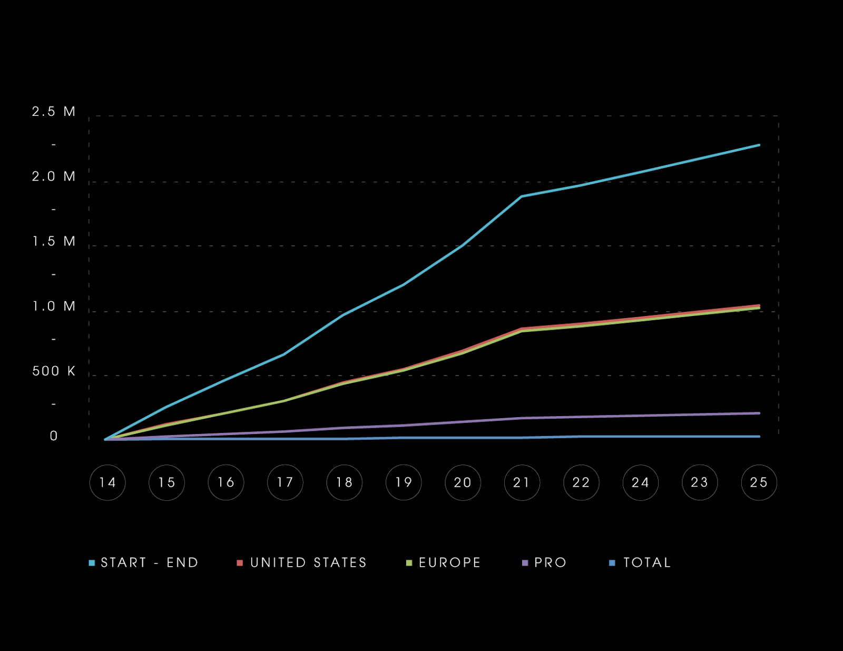
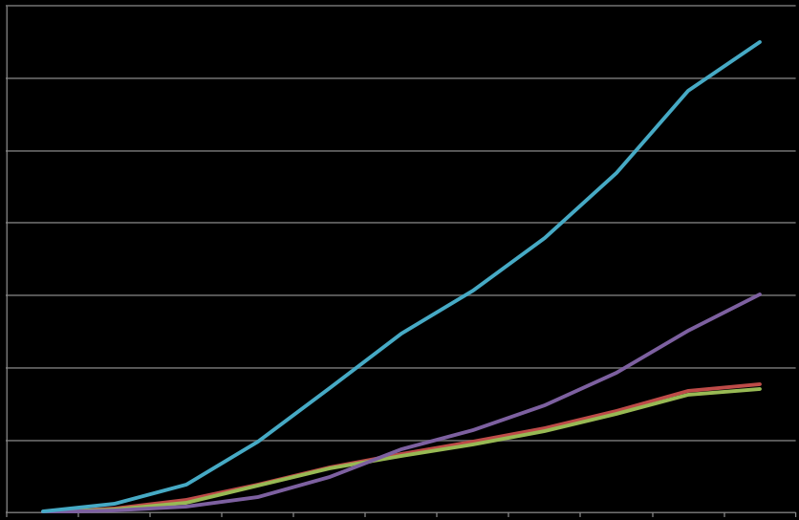
Financials: Years 2014 - 2025: Subscribers (graph)
14
12
10
8
m i l l i o n s
6
4
2
UNITED STATES
EUROPE
OTHER
TOTAL
(Comprehensive financial model available on request)
(Comprehensive financial model available on request)

Slide 11
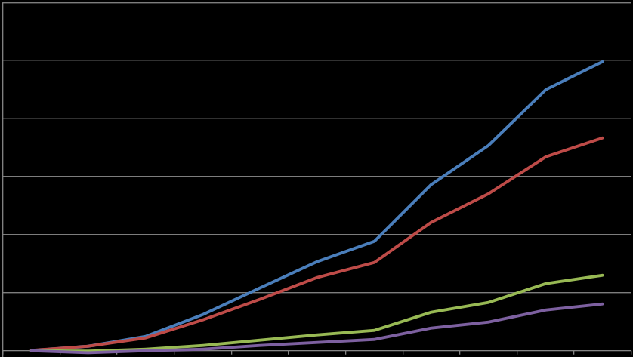
Financials: Years 2014 - 2025: Projected Revenue, Expenses, EBITDA & Free Cash Flow
1,200,000
1,000,000
800,000
600,000
400,000
200,000
(Comprehensive financial model available on request)

Slide 12
You never change things by fighting the existing reality.
To change something, build a new model that makes the existing model obsolete.
- BUCKMINSTER FULLER

